Slide 1
Predicitve Modeling for Identifying At-Risk Customers and Minimizing Churn

Slide 2
Problem Statement:
As a Data Analyst, the project aims to delve into extensive datasets from both banking and telecom domains to understand customer churn dynamics.
By leveraging various customer-related features such as demographics, transaction history, and activity status, the goal is to analyze patterns and build predictive models capable of forecasting customer churn.
Through comprehensive data analysis, feature engineering, and model development, the project seeks to empower businesses with actionable insights to implement targeted retention strategies and enhance customer loyalty.

Slide 3
Analysis Objectives:
1.Identifying Key Churn Drivers
Determine which factors contribute most significantly to customer churn within the banking and telecom industries.
Analyze the correlation between different customer attributes and the likelihood of churn.
Identify patterns or trends that distinguish churned customers from those who remain active.
2. Segmentation of Customer Base
Segment customers based on their demographic characteristics, transactional behavior, and activity status.
Explore distinct customer segments and their respective churn rates.
Identify high-value segments that are more prone to churn and those that are more loyal.

Slide 4
Analysis Objectives:
3. Predictive Modeling for Churn Prediction
Develop predictive models using machine learning algorithms to forecast which customers are likely to churn in the future.
Evaluate the performance of various models and select the most accurate and reliable one for deployment.
Assess the predictive power of different features and their impact on model performance.
4. Customer Lifetime Value (CLV) Analysis
Calculate the CLV for different customer segments to understand the revenue potential associated with each group.
Determine how churn rates affect the CLV of different customer segments.
Explore strategies to maximize CLV while minimizing churn.

Slide 5
Analysis Objectives:
5. Retention Strategy Recommendations
Develop predictive models using machine learning algorithms to forecast which customers are likely to churn in the future.
Evaluate the performance of various models and select the most accurate and reliable one for deployment.
Assess the predictive power of different features and their impact on model performance.
6. Continuous Monitoring and Iterative Improvement
Establish mechanisms for ongoing monitoring of churn rates and customer behavior patterns.
Implement feedback loops to continuously refine predictive models and retention strategies based on real-time data.
Track the impact of implemented strategies on reducing churn and increasing customer loyalty over time.

Slide 6
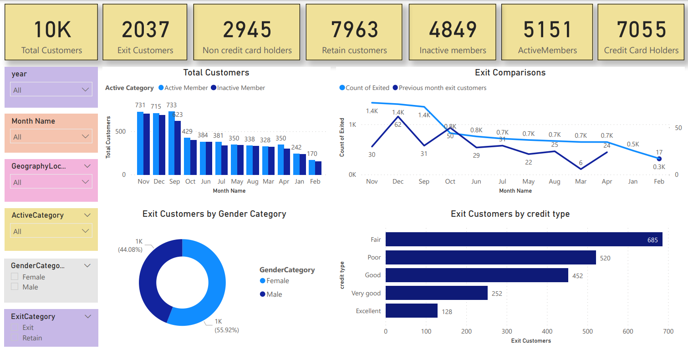

Slide 7
Dashboard Analysis
Total Customers: The number of total customers is increasing. In November there were 715,733 customers and this number increased to 733,731 in December. This is an increase of around 18,000 customers.
Exit Customers: The number of exit customers is also increasing. There were 1,400 exit customers in November and 1,700 in December. This is an increase of around 300 customers.
Customer Demographics: The majority of the exit customers are male (55.92%) and in the "fair" credit category (44.08%).
Active Customers: The number of active customers is also increasing. There were 429,000 active customers in November and 484,900 in December. This is an increase of around 56,000 customers.

Slide 8
Overall Analysis
Overall, the dashboard suggests that the company is acquiring new customers at a faster rate than it is losing them. However, the number of exit customers is also increasing, so it is important to investigate the reasons for this churn.
Here are some additional questions that the dashboard could help answer:
What are the reasons why customers are exiting?
Are there any particular demographics or customer segments that are more likely to exit?
What can be done to reduce churn?

Slide 9
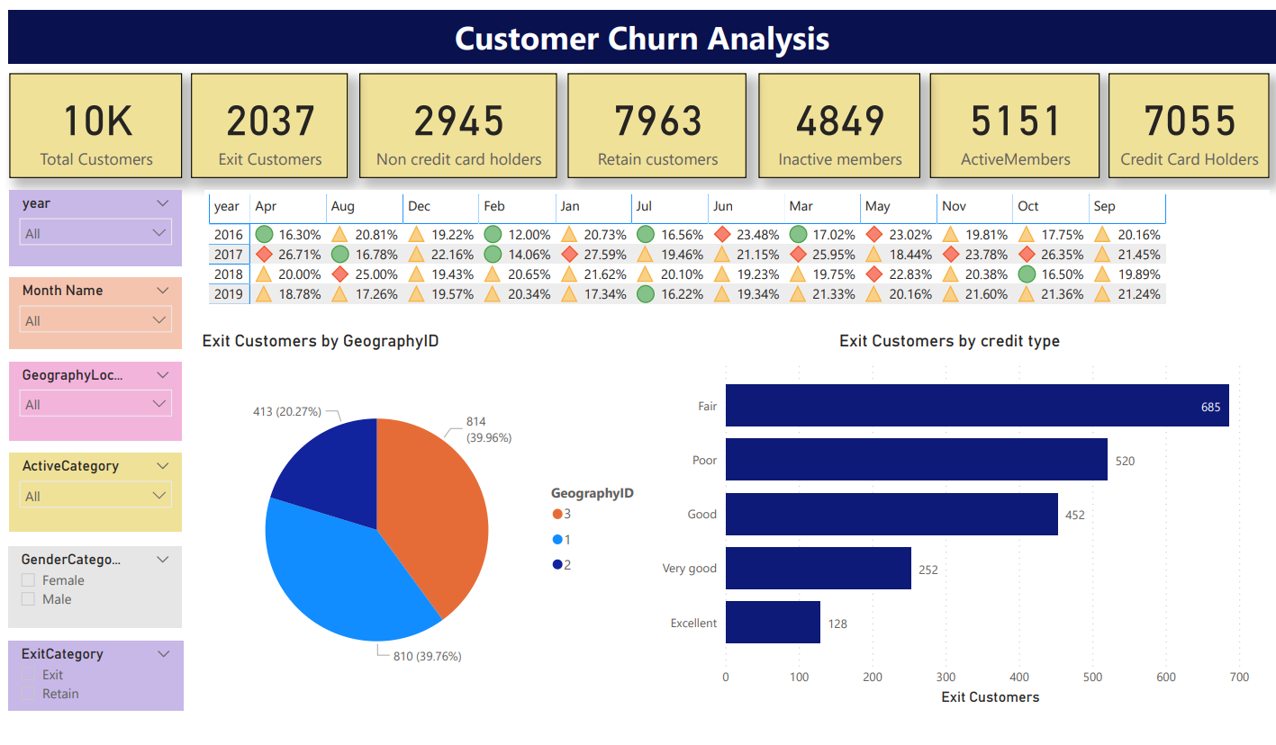

Slide 10
Dashboard Analysis
Churn Rate: The churn rate, represented by "Exit Customers" as a percentage of "Total Customers", fluctuates throughout the year. It's generally higher in the first half of the year, reaching peaks in April (26.71% in 2017) and May (23.02% in 2016). December tends to have the lowest churn rates, with December 2019 having the lowest at 12.00%.
Credit Card Holders vs Non-Credit Card Holders: Customers who have credit cards tend to churn less than those who don't. For instance, in December 2019, the churn rate for non-credit card holders was 39.96%, whereas it was only 21.36% for credit card holders.
Active vs Inactive Members: Active members churn less than inactive members. In December 2019, for example, the churn rate for inactive members was 21.60%, whereas it was only 16.22% for active members.

Slide 11
Thank You!

